Slide 1
Data Visualization & Interpretation
Febin.A.Vahab

Slide 2
A Strategic Dashboard
Sample Sales Dashboard:A sales manager might use this dashboard to monitor sales performance and opportunities
Measures Used
Sales revenue
Sales revenue in the pipeline (expected revenue divided into categories of probability)
Profit
Customer satisfaction rating
Top 10 customers
Market share

Slide 3
Decisions to be made
At what level of summarization should I express this measure?
What unit of measure should I use to express this measure?
What complementary information should I include as context to enhance this measure's meaning?
What means of display would best express this measure?
How important is this measure to a sales manager compared to the other measures?
At what point in the sequence of viewing the items on the dashboard might a sales manager want to see this measure?
To what other measures might a sales manager want to compare this measure?

Slide 4
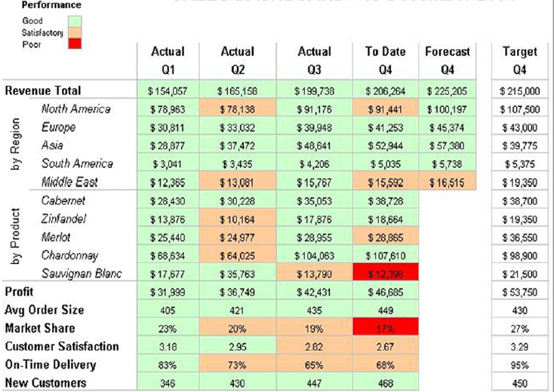
SALES DASHBOARD-1

Slide 5
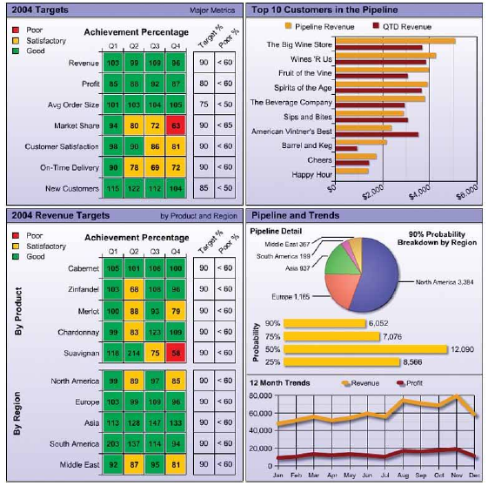
SALES DASHBOARD-2

Slide 6
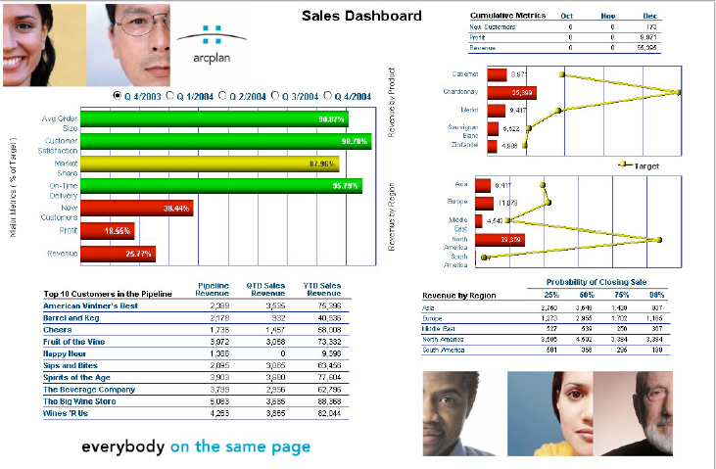
SALES DASHBOARD-3

Slide 7
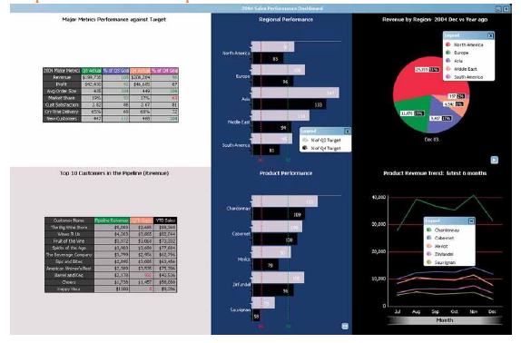
SALES DASHBOARD-4

Slide 8
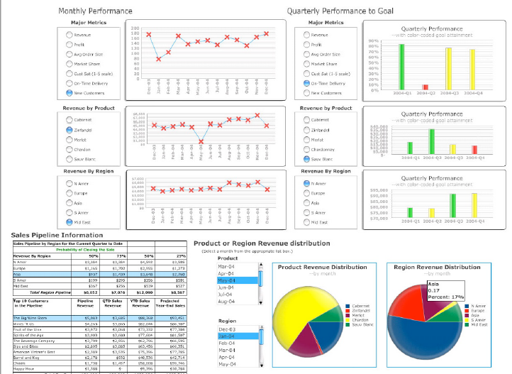
SALES DASHBOARD-5

Slide 9
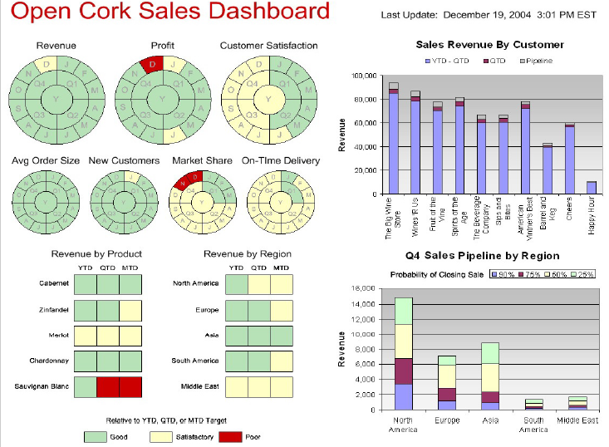
SALES DASHBOARD-6

Slide 10
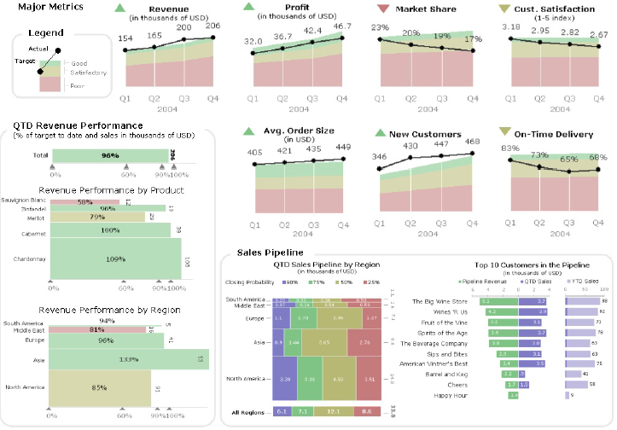
SALES DASHBOARD-7

Slide 11
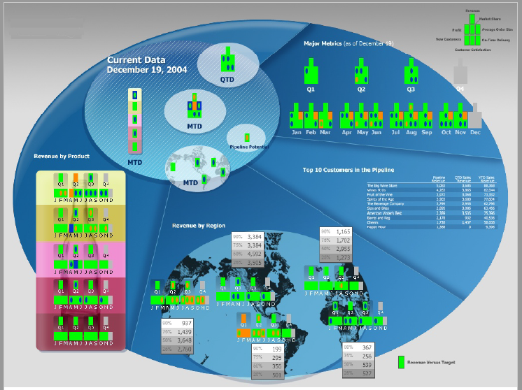
SALES DASHBOARD-8

Slide 12
SALES DASHBOARD-8-Key

Slide 13
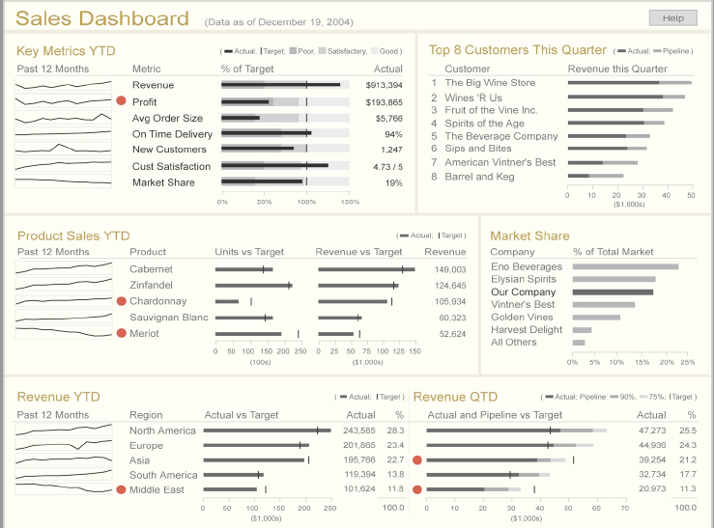
SALES DASHBOARD-FINAL

Slide 14
A Strategic and Operational Dashboard
Sample CIO dashboard : A Chief Information Officer (CIO) might use this dashboard to monitor several aspects of a company's information systems
System availability (uptime)
Expenses
Customer satisfaction
Severe problem count
CPU usage relative to capacity
Storage usage relative to capacity
Network traffic
Application response time
Major project milestones
Top projects in the queue
Other critical events

Slide 15
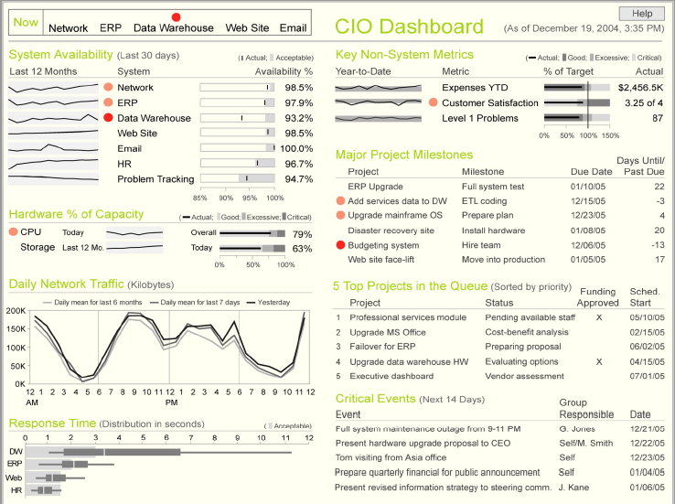

Slide 16
Operational Dashboard
Sample telesales dashboard The supervisor of a team of sales representatives who take orders and answer questions by phone might use this dashboard to monitor performance.
Call wait time
Call duration
Abandoned calls (that is, callers who got tired of waiting and hung up)
Call volume
Order volume
Sales representative utilization (representatives online compared to the number available)

Slide 17
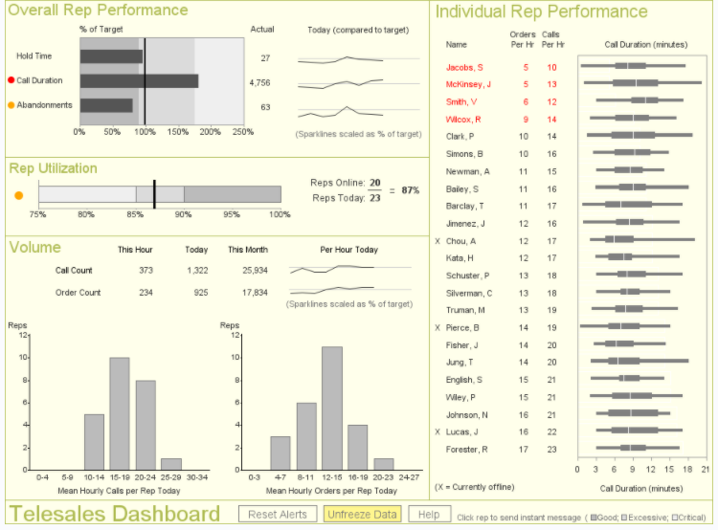

Slide 18
Analytical Dashboard
Sample marketing analysis dashboard A marketing analyst might use this dashboard to monitor the marketing performance of the company's web site.
Number of visitors (daily, monthly, and yearly)
Number of orders
Number of registered visitors
Number of times individual products were viewed on the site
Occasions when products that were displayed on the same page were rarely purchased together
Occasions when products that were not displayed on the same page were purchased together
Referrals from other web sites that have resulted in the most visits

Slide 19
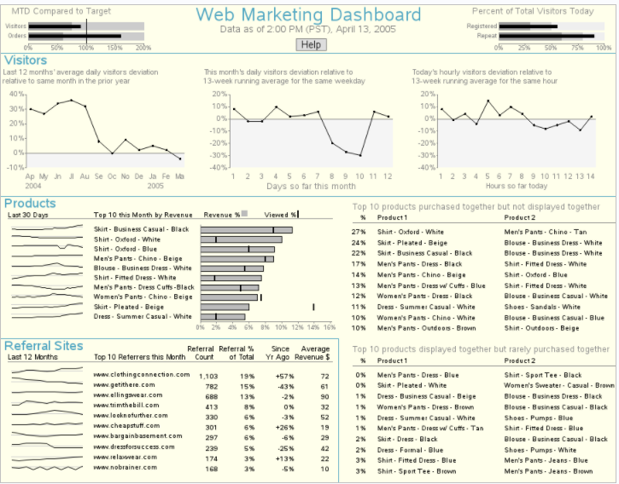

Slide 20
Thank You!

